Slide 1

Blue Jay Shuttle
Data Analysis
Meeting 2 - 2/11/22
Miles Lee & Vivian Hung
Notes:
Make a query for this:
- Power Plant: Want to know about how many people (and what time) will they go and leave per week?

Slide 2
OVERVIEW
01
03
02
04
Timeline Reminder
Data Organization, Storage, Pipeline Platform
Data Exploration and Questions
Next Steps
Notes:
viv

Slide 3
ROUGH TIMELINE
Have an understanding of the data source and potential ways the data can be used.
February
Data storage & computing platform
Develop a data pipeline (cleaning, transforming, preparing)
April
Create different statistical models
June
August
Produce dynamic dashboards for seamless business use
Notes:
Miles

Slide 4
Data Exploration & Privacy Questions
Questions about Meta Analysis, Lyft Data & Transloc Data
About the data and what we need to uniquely identify each instance (row)
  Each data set has Name, Phone, Address, and Email
  We need a way to connect the datasets by using an identifier from each table
  We want to use Date + Time + Phone Number
    Is this a privacy concern?
Notes:
viv
Bullet #4: What does “in the red” look like to you? What is a good day versus a bad day?
Transportation dashboard for passengers

Slide 5
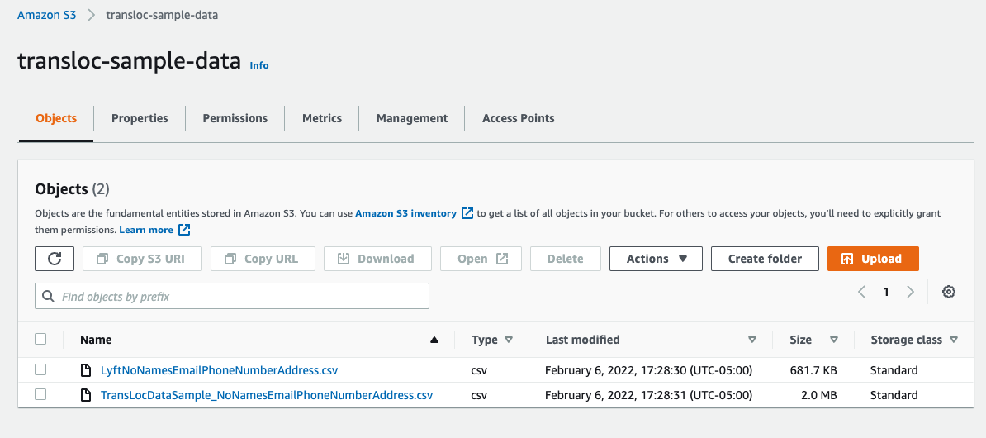
AWS Storage, Pipeline, & Computing Platform
What is it?
Remote storage
Remote computing: data cleaning, transformation, statistical models.
Easy connection to Applications: Tableau
Why are we using it?
Scalable
Cost effective (Free for < 1 year)
Remote work
Better computation and greater storage ability.
Allows for easy reproducibility
Integrated AWS products make the data pipeline simpler.
Drawbacks?
Some cost association after a year
Initially difficult to manage / learn.
Notes:
Miles
Note: we are only using a small fraction of AWS.

Slide 6
NEXT STEPS
AWS
  Setting up data pipeline in AWS
    S3 → Glue/Lambda → RDS/S3/other
  Set up dashboarding
    RDS/S3/other → Athena → Tableau
  Set up statistical modeling
    RDS/S3/other → Lambda/EC2
Data Exploration
Miles I-9 Done
Notes:
Miles
Rob will work with miles 1:1 to get files – straight forward w login – try over email first
Feb 11th 1pm est/10am pst

Slide 7
THANKS
Miles Lee & Vivian Hung
mlee276@jhu.edu | vvnhng@uw.edu

Slide 9
OUR PROCESS
1
3
5
2
4
Data Understanding and Exploration
Analysis, Predictions, Models
Business Issue Understanding
Data Preparation and Wrangling
Validation and Feedback
Notes:
viv

Slide 10
Q&A
Notes:
Hopes + prayers:
Worth our time and effort
If at the end, no product but we still learned: good!
Anything else: gravy
Rob keeps track of all ridership data in spreadsheet
Per year
People want to see the data more finely
Boss likes to see charts and graphs
Daily/weekly/monthly
Time sensitive questions: Look at the data, tell us x
How many people went downtown last night
What are the biggest parties and what days are they?
Can you give me a location of x?
We found midway through, students are going to power plant live thurs, fri, saturday nights
If things continue in the springtime, when and how many people will need rides?
10pm, 1-2am
Solution: sent a bus
Note: start data from january 2021

Slide 11
LOGISTICS
DATA ACQUISITION
MEETING TIMES
BLAH BLAH
What are the tools, procedures, and security measures involved in acquiring the data?
How will we organize our meetings? Should we create a group chat? Microsoft teams / calendar?
“Jupiter is a gas giant and
the biggest planet in the
Solar System”

Slide 12
UNDERSTANDING THE PROBLEM
MARS
JUPITER
MERCURY
Despite being red, Mars is actually a cold place
It’s a gas giant, the biggest planet in the Solar System
Mercury is the closest planet to the Sun and the smallest one

Slide 13
OUR QUESTIONS
MERCURY
VENUS
MARS
Mercury is the closest planet to the Sun
Venus has a beautiful name, but it’s terribly hot
Despite being red, Mars is actually a cold place
SATURN
NEPTUNE
JUPITER
Saturn is the ringed one and a gas giant
Neptune is the farthest planet from the Sun
It’s the biggest planet in the Solar System

Slide 14
STEPS TO FOLLOW
Here you can add the steps to perform
Here you can add the steps to perform
Here you can add the steps to perform
Here you can add the steps to perform
Here you can add the steps to perform
Here you can add the steps to perform
Here you can add the steps to perform
Here you can add the steps to perform
Here you can add the steps to perform
Here you can add the steps to perform

Slide 15
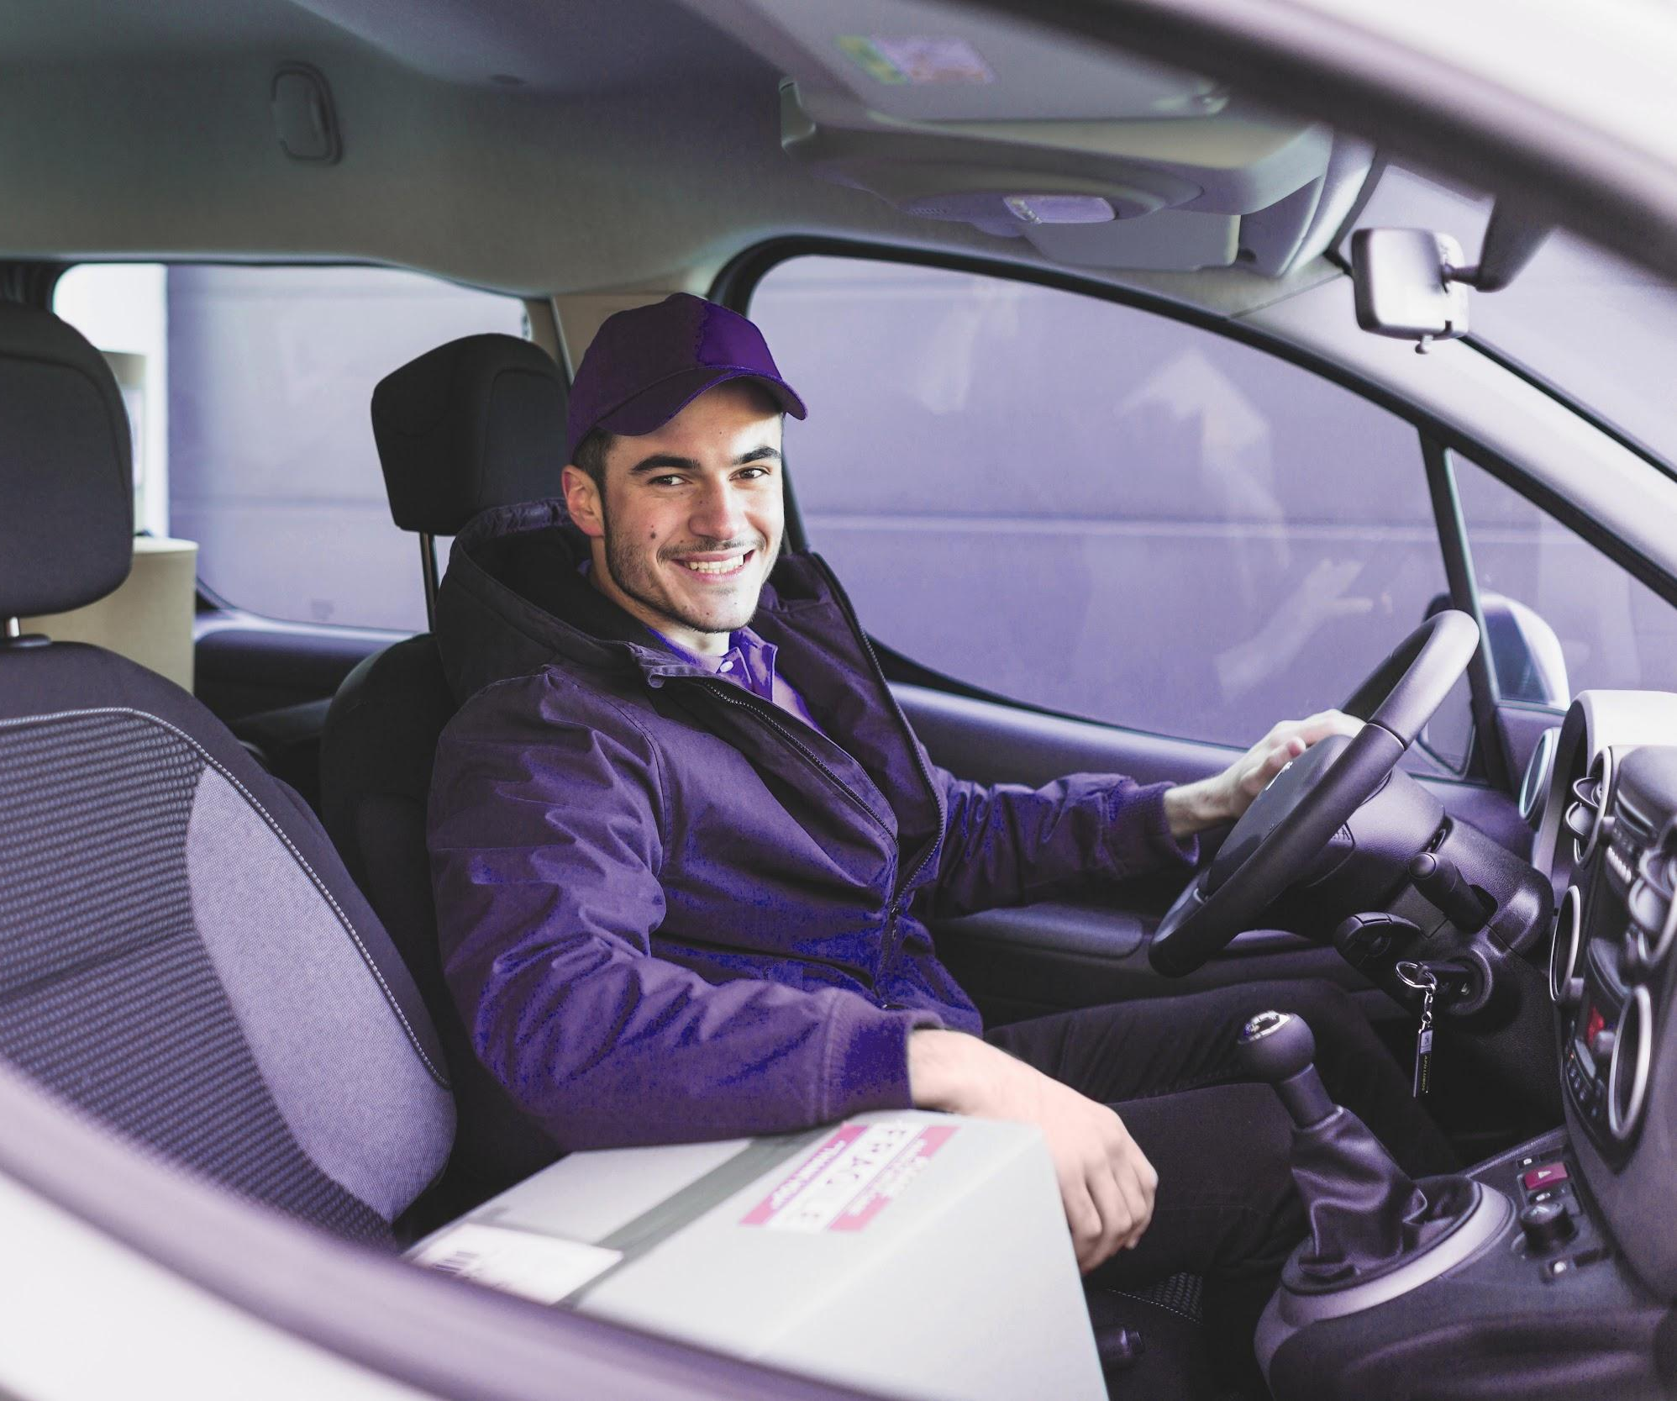
MERCURY
Mercury is the closest planet to the Sun and the smallest one in the Solar System—it’s only a bit larger than the Moon

Slide 16
NEXT STEPS
JUPITER
SATURN
Jupiter is the biggest planet in the Solar System
Saturn is composed of hydrogen and helium
MARS
URANUS
Despite being red, Mars is actually a cold place
Uranus has a beautiful name, but it’s terribly hot

Slide 17
OUR SOLUTIONS
MARS
JUPITER
Despite being red, Mars is a cold place. The planet is full of iron oxide dust
Mercury is the closest
planet to the Sun and the smallest of them all

Slide 18
MAIN COMPETITORS
JUPITER
MERCURY
VENUS
MARS

Slide 19
01
OUR SERVICES
You can enter a subtitle here if you need it

Slide 20
TWO COLUMNS
VENUS
SATURN
Venus has a beautiful name, but it’s terribly hot, even hotter than Mercury
Saturn is the ringed one. It’s a gas giant, composed mostly of hydrogen and helium

Slide 21
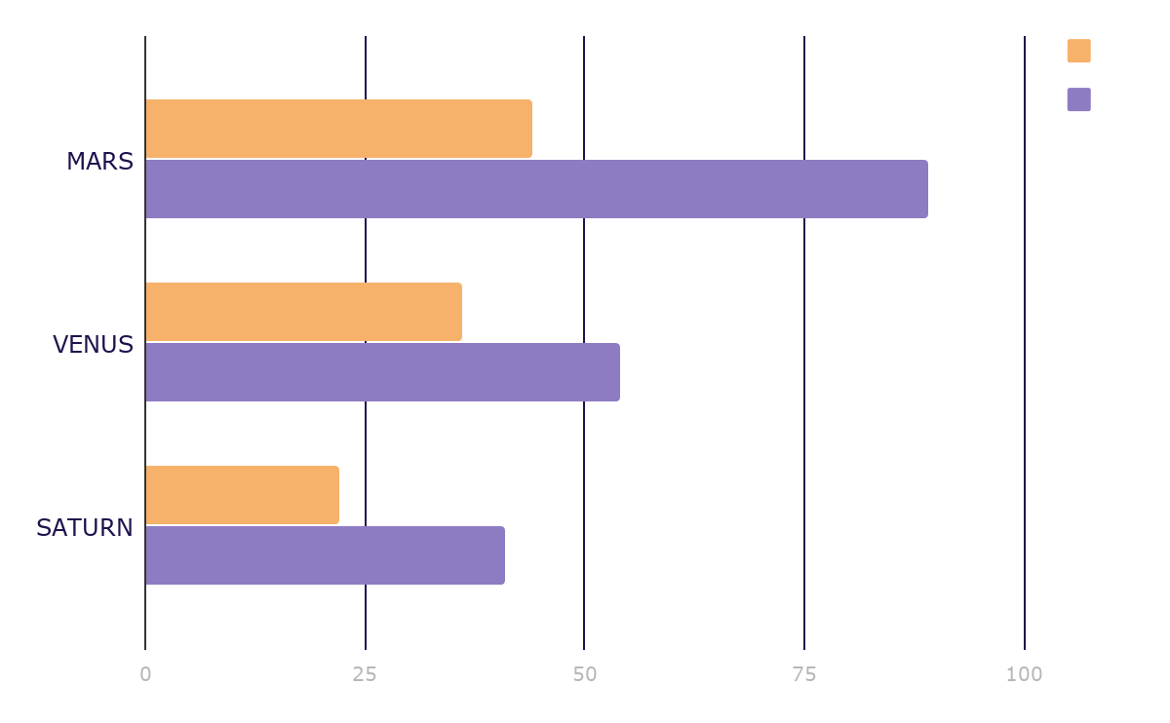
MARKET RESEARCH
JUPITER
Jupiter is a gas giant and the biggest planet in the Solar System
MERCURY
Mercury is the smallest planet in the Solar System
To modify this graph, click on it, follow the link, change the data and paste the resulting graph here

Slide 22
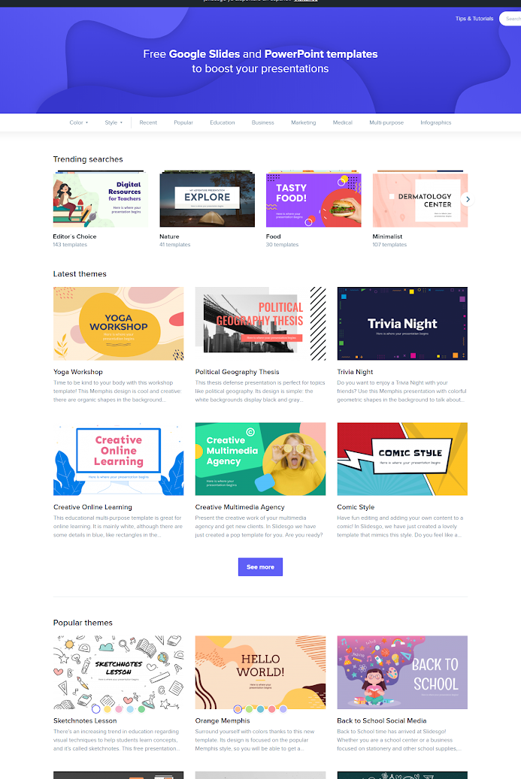
MOBILE APP
You can replace the image on the screen with your own work. Just delete this one, add your and place it in the center of the device

Slide 23
ANALYSIS
TOP RATED VALUES
OUTREACH
Saturn
Venus
Mars
15,000,000
Worldwide Users

Slide 24
CUSTOMER PROFILE
40%
60%
$50.00
20-35
36-45
46-50
Average Spend Per Customer
AGE

Slide 25
15,000,000
Big numbers catch your audience's attention

Slide 26
LOGISTICS
Venus has a beautiful name and is the second planet from the Sun
DATA ACQUISITION
Mercury is the closest planet to the Sun and the smallest one
MEETINGS
Jupiter is a gas giant and the biggest planet in the Solar System
BLAH

Slide 27
02
NAME OF THE SECTION
You can enter a subtitle here if you need it

Slide 28
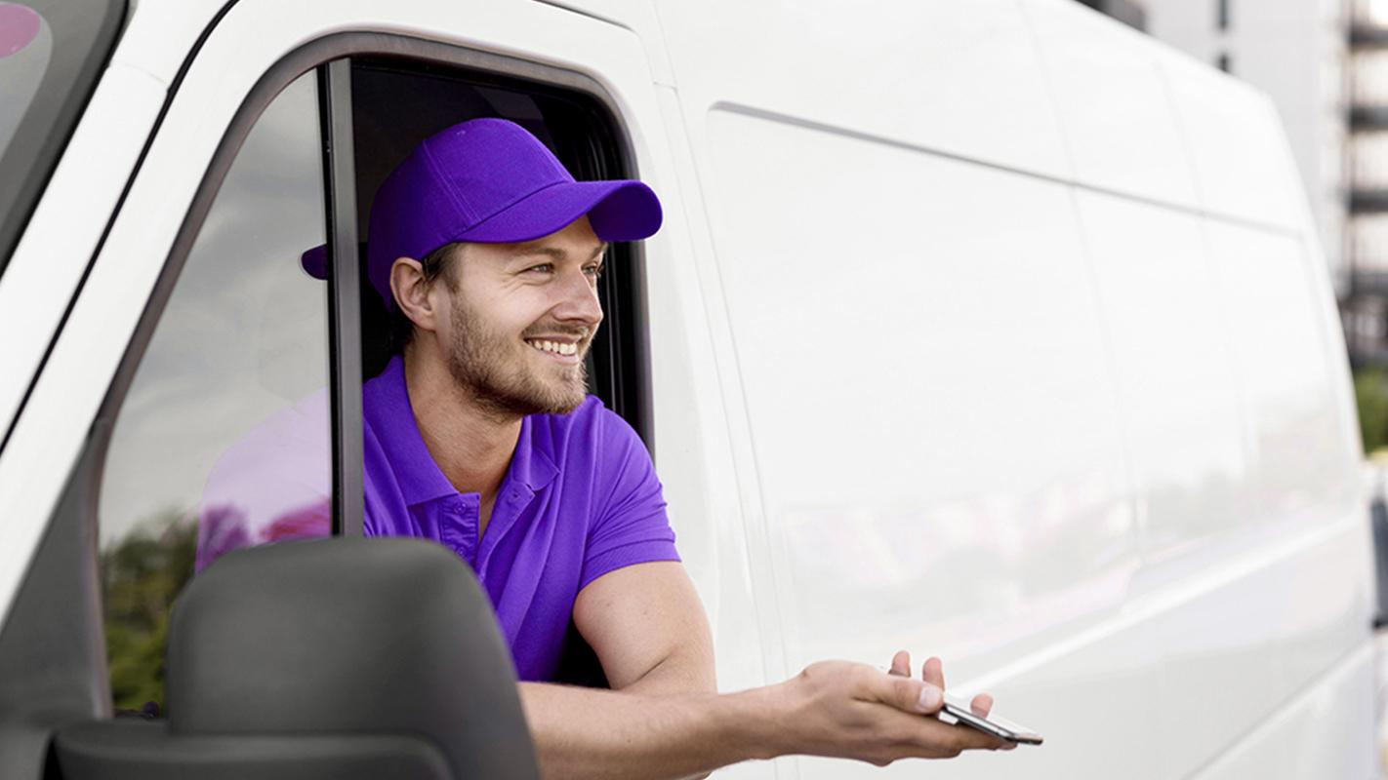
A PICTURE IS WORTH A THOUSAND WORDS

Slide 29
ALTERNATIVE RESOURCES

Slide 30
Fonts & colors used
This presentation has been made using the following fonts:
Oswald Semi-Bold
(https://fonts.google.com/specimen/Oswald)
Lato Regular
(https://fonts.google.com/specimen/Lato)
#f6b26bff
#d9d2e9ff
#b4a7d6ff
#8e7cc3ff
#351c75ff
#20124dff

Slide 31
...and our sets of editable icons
You can resize these icons without losing quality.
You can change the stroke and fill color; just select the icon and click on the paint bucket/pen.
In Google Slides, you can also use Flaticon’s extension, allowing you to customize and add even more icons.

Slide 32
Educational Icons
Medical Icons

Slide 33
Business Icons
Teamwork Icons

Slide 34
Help & Support Icons
Avatar Icons

Slide 35
Creative Process Icons
Performing Arts Icons

Slide 36
Nature Icons

Slide 37
SEO & Marketing Icons

